Slide 1

Smart Medicine Reminder with Heartbeat Detection and RTC Alarm System
01

Slide 2
ABSTRACT
09
This project implements a microcontroller-based real-time clock and alarm system with an integrated heartbeat monitoring feature. Using the LPC2138 microcontroller, the system includes a 16x2 LCD for displaying time, alarms, and heartbeat data, a keypad for user input, a buzzer for notifications, and an ADC-connected heartbeat sensor. Users can set alarms via the keypad, triggering medication reminders displayed on the LCD alongside buzzer alerts. The heartbeat module will generate the pulse which will be displayed in the digital oscilloscope. Designed for healthcare and wellness applications, the system ensures precise timekeeping, efficient alarm management, and real-time health monitoring in a compact, user-friendly design.

Slide 3
04
LPC2148 MICROCONTROLLER
16X2 LCD DISPLAY
COMPONENTS USED
4X4 MATRIX KEYPAD
PUSH BUTTON
SPEAKER
HEART BEAT SENSOR

Slide 4
04
GPIO( GENERAL PURPOSE INPUT OUTPUT PINS)
PERIPHERALS USED
)
ADC ( ANALOG TO DIGITAL CONVERTER)
REAL-TIME CLOCK (RTC)

Slide 5
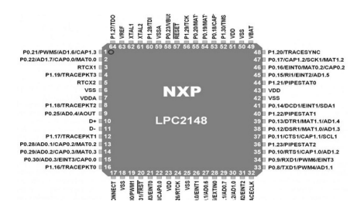
WORKING PRINCIPLE
Real-Time Clock (RTC) Functionality:
The LPC2148 microcontroller, which includes an inbuilt Real-Time Clock (RTC), is responsible for continuously counting real-time data, including seconds, minutes, hours, days, months, and years.
The RTC is powered by a 32.768 kHz oscillator or a programmable prescaler divider from the APB clock. It maintains accurate time and calendar functionality even in low-power mode.

Slide 6
WORKING PRINCIPLE
Alarm Setup:
The microcontroller supports alarm functionality. When the set alarm time matches the real-time clock, an interrupt is triggered. The speaker can be triggered to produce sounds
User Interaction:
A 4x4 matrix keypad is interfaced with the microcontroller to allow user input.
Users can configure the clock, edit the current time, or set alarm times via the keypad. Pressing the edit button generates an interrupt, enabling these functionalities.

Slide 7
WORKING PRINCIPLE
LCD Display:
A 16x2 LCD is used to display the current time, alarm settings, and notifications like medicine reminders.
The display updates in real-time, reflecting changes made by the user.
Power Supply:
The system is powered by a 3.3V DC power supply. The RTC is also capable of operating on battery backup for low-power modes, ensuring uninterrupted operation.

Slide 8
WORKING PRINCIPLE
HEART BEAT SENSOR
The heartbeat sensor works by detecting the blood flow variations in the fingertip caused by heartbeats. It uses a light-emitting diode (LED) and a photodetector to measure these variations. When the fingertip is placed on the sensor, the LED emits light, and some of this light is absorbed by the blood, while the rest is reflected back to the photodetector. During each heartbeat, the blood volume increases, causing a corresponding change in the amount of light absorbed and reflected. These fluctuations are converted into electrical signals, processed by the microcontroller, and used to calculate the beats per minute (BPM).

Slide 9
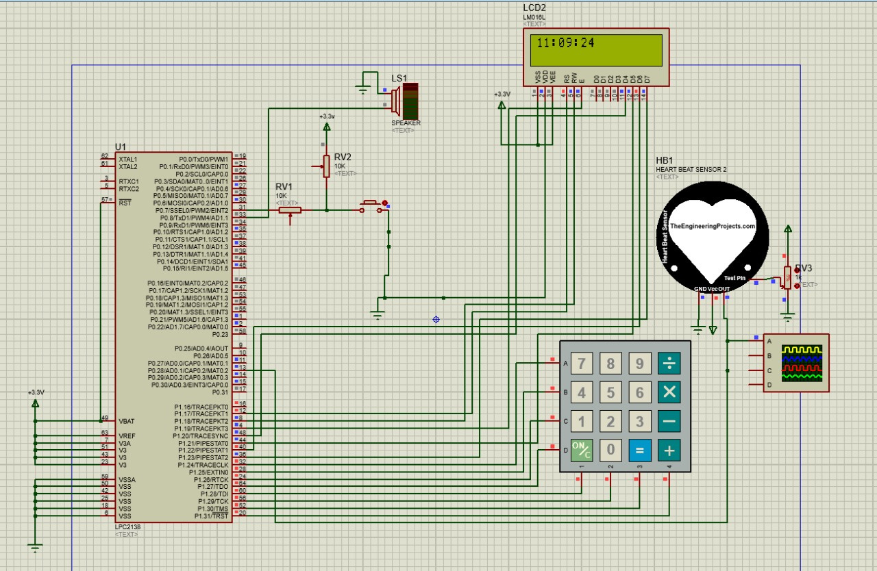
CIRCUIT DIAGRAM

Slide 10
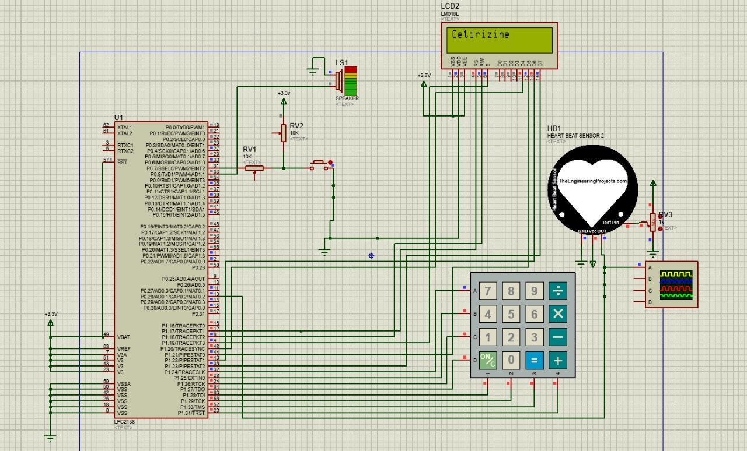
SIMULATION RESULTS

Slide 11
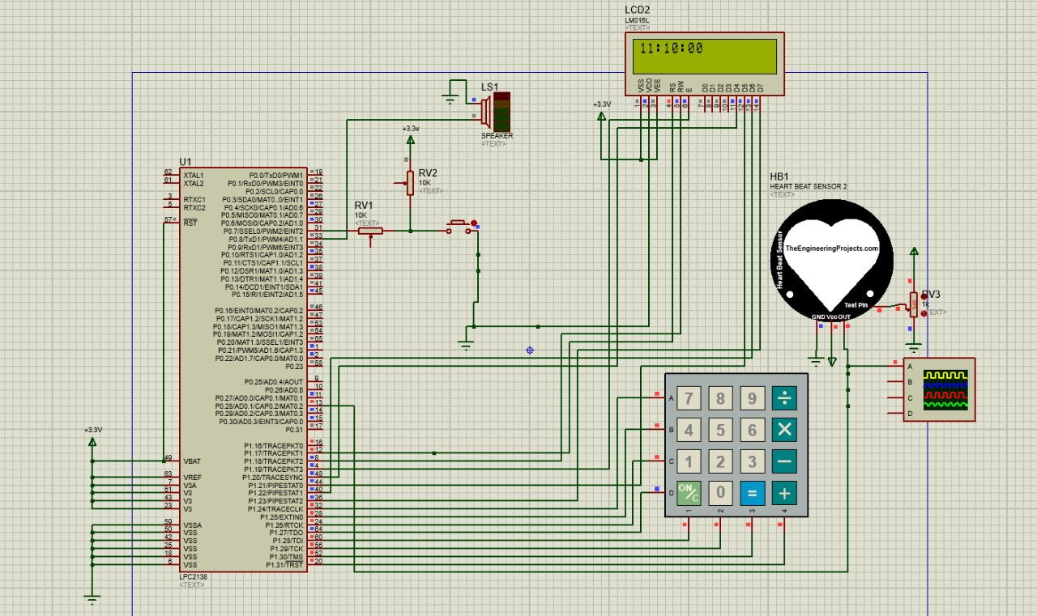
SIMULATION RESULTS

Slide 12
CONCLUSION
THE SMART MEDICINE REMINDER WITH HEARTBEAT DETECTION AND RTC ALARM SYSTEM EFFECTIVELY COMBINES REAL-TIME CLOCK (RTC) FUNCTIONALITY WITH HEARTBEAT MONITORING TO ADDRESS CRITICAL HEALTHCARE NEEDS. THE SYSTEM PROVIDES TIMELY MEDICINE REMINDERS THROUGH AN AUDIBLE BUZZER AND VISUAL ALERTS ON AN LCD, ENSURING PATIENTS ADHERE TO THEIR MEDICATION SCHEDULES. ADDITIONALLY, THE HEARTBEAT DETECTION FEATURE ENABLES BASIC HEALTH MONITORING BY CALCULATING BEATS PER MINUTE (BPM), WHICH IS ESPECIALLY USEFUL FOR INDIVIDUALS WITH MEDICAL CONDITIONS. BY INTEGRATING PERIPHERALS SUCH AS A KEYPAD, LCD, AND HEARTBEAT SENSOR WITH THE LPC2138 MICROCONTROLLER, THIS PROJECT DEMONSTRATES A RELIABLE, USER-FRIENDLY, AND COST-EFFECTIVE HEALTHCARE SOLUTION.

Slide 13
RAVI TEJA.M
AM.EN.U4ECE22024
President
VIVEKANANDA.N
AM.EN.U4ECE22028
President
JHANSI LAKSHMI.P
AM.EN.U4ECE22035
GROUP 5
President
SASANK.K
AM.EN.U4ECE22055
President
S.SAI SRI SAHITI
AM.EN.U4ECE22058
President

